Slide 1
Once Upon a Login
How Logon Sessions Help Defenders See the Bigger Picture

Slide 2

About Me
Consultant @SpecterOps
Defensive Security Researcher
Detection, Threat Hunting, Compromise Assessments
Windows Internals, All Things Data, Reverse Engineering
Formerly Sr. Threat Researcher @RedCanary
Host of the Detection: Challenging Paradigms Podcast

Slide 3
Overview
The “Why”?
What are logon sessions?
Defensive Capabilities
Available Telemetry
Test-Cases
PowerShell Script Drop

Slide 4
The “Why”
Majority of detection and investigation strategies are heavily process centric
This leads to A LOT of analysis for the analyst
Potential “lost” activity
TIME CONSUMING
Notes:
Due to investigation and detection strategies, we often forget that these “processes” are operations being performed.
Common flow:
Alert drops
Search box, user, timestamp
Find bad around the alert
Classify, move on?
Analysts get caught up in the PROCESS not the OPERATION
Unnecessary Rabbit Holes
Logon Session Centric data is a way for analysts to be more targeted with their searches

Slide 5
Logon Sessions
Logon
Session Initialization
Authentication
Origin Token Creation
Notes:
The “logon process” is really a mixture of 3 main components:
The user initializing the logon, whether that is hands on keyboard, remotely, etc and putting in a password
The authentication package/security support provider process
The origin token creation of the new logged on user
For what we are going to talk about, we will go through the last 2 pieces of this flow.

Slide 6
Logon Sessions
Session that is created upon a user’s successful logon
Terminates when the user is logged off
Referenced via a LogonId value
LowPart of LUID structure
If the user that logs in has High IL privileges (administrative privileges) 2 logon sessions are generated. Known as a split token/linked token.
1 for Medium IL session
1 for High IL session

Slide 7
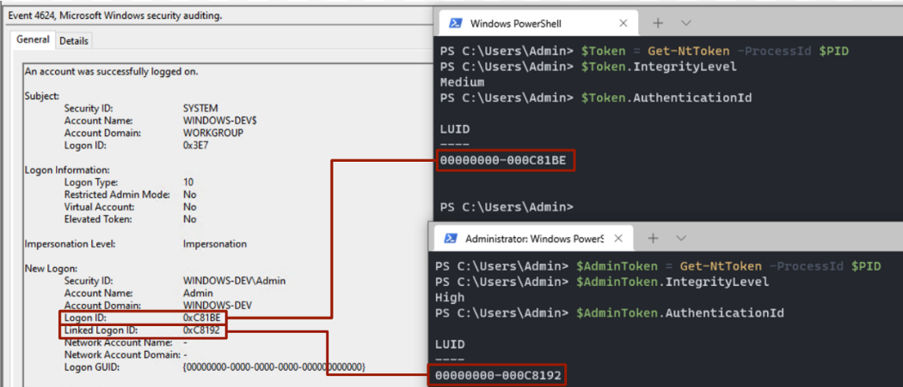
Split Token Example
Notes:
The LowPart is the last 8 digits shown
Each one of those hex digits are 4 bits, making up the 32-bit DWORD value of the LowPart LUID
It is possible for tools to show the LogonId value as a decimal value instead of a hex value (MDE for example)

Slide 8
Access Tokens
Securable objects that serve to identify the security context of processes/threads
Contain information–
User SID
Group Memberships
Privileges
Logon ID/Logon Session
Represented in the kernel via TOKEN structure
Generated after authentication
1 token per logon session
Notes:
1 token per logon session
- 1 to represent High IL, 1 to represent Medium IL

Slide 9
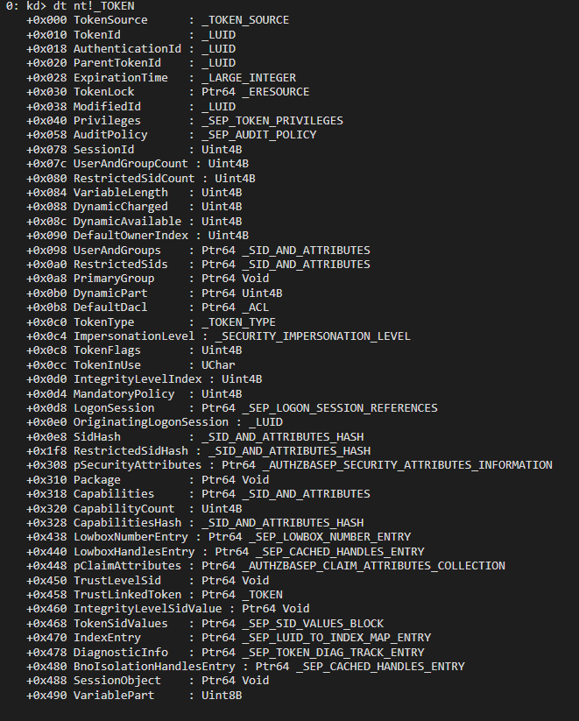
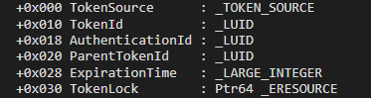
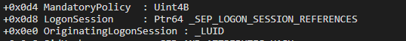
Logon Sessions in Token Structure

Slide 10
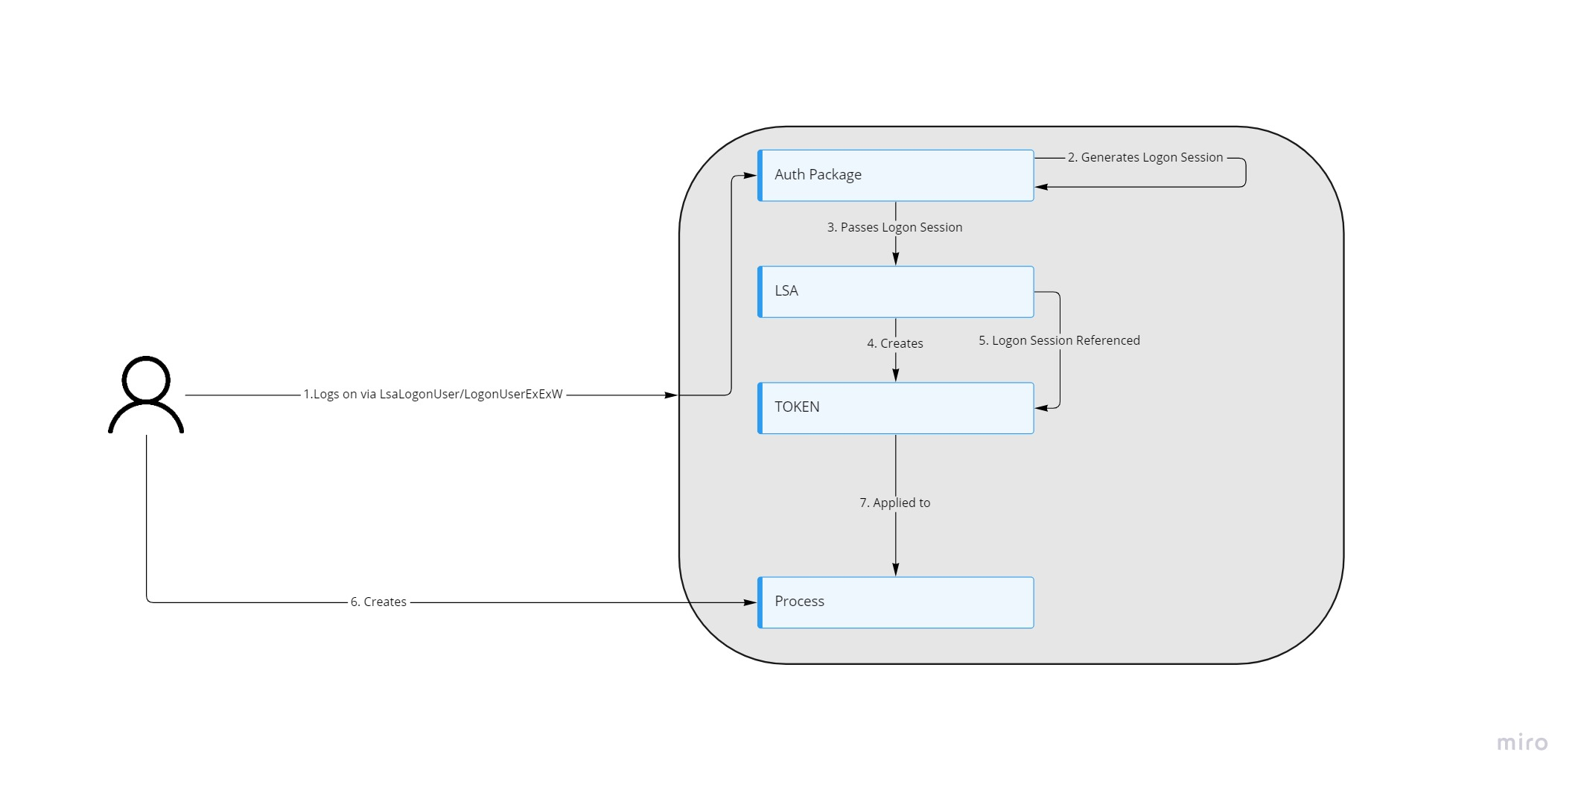
Logon Session Generation Process
Notes:
Logon is requested and user’s credentials are exposed
Authentication package takes those credentials and authenticates user
Authentication package creates a logon session and gives it to LSA (LSASS)
A Token (potentially more then 1) is created for that user
Logon Session is referenced within the token structure via members - AuthenticationId (LogonId - LUID) or LogonSession (_SEP_LOGON_SESSION_REFERENCES)

Slide 11
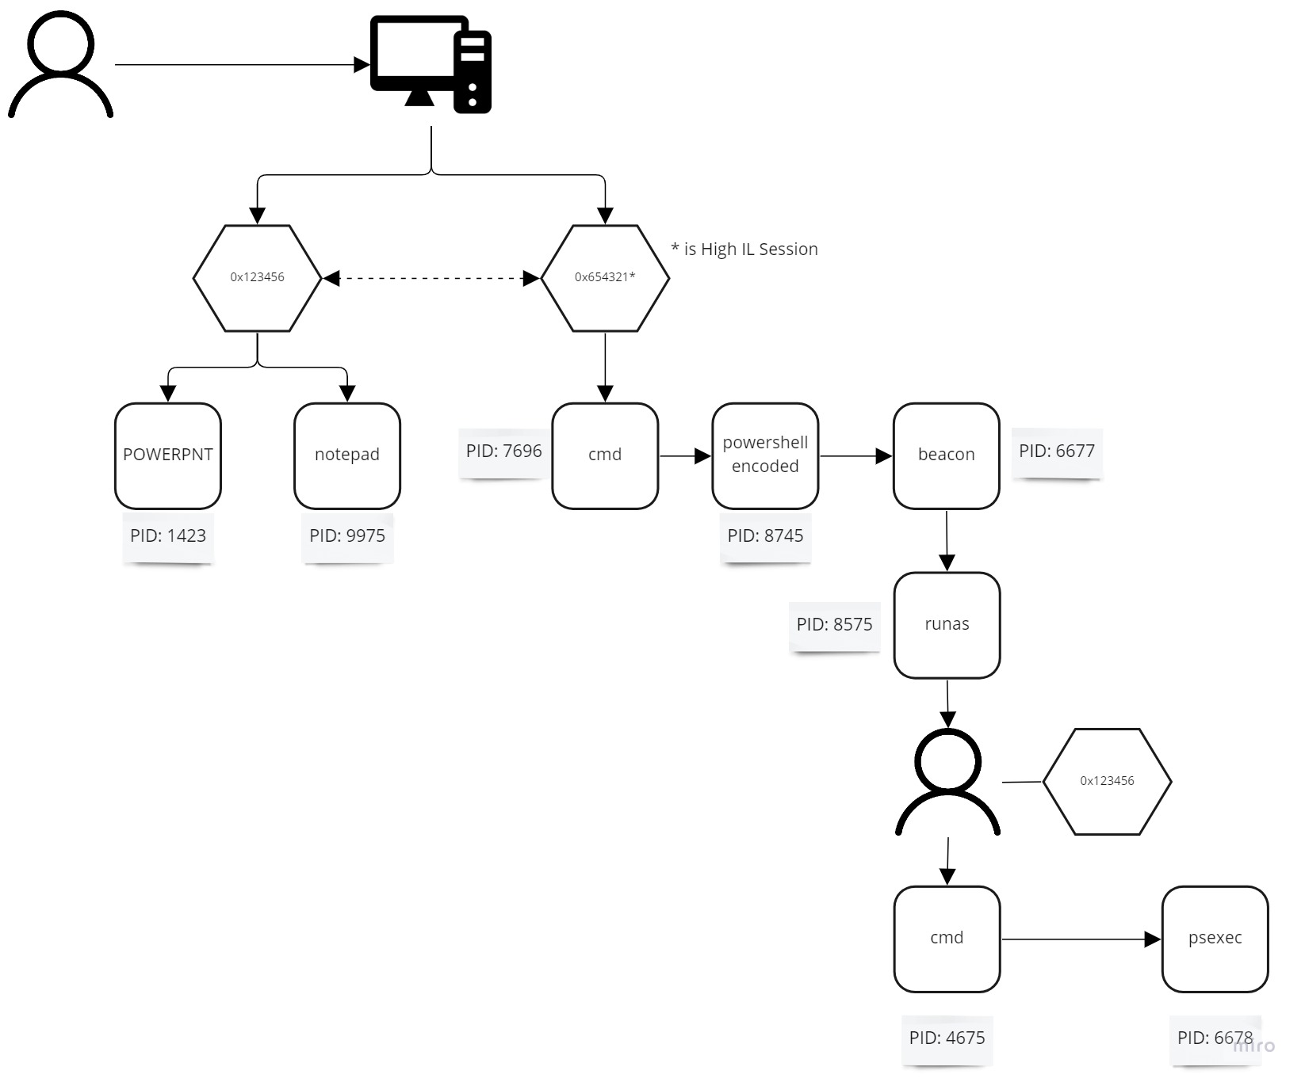
Notes:
Process Ids are not unique and can be replicated.
Mention the previous walk though from an investigation standpoint and the new methodology

Slide 12
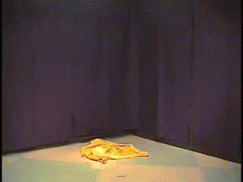
Defensive Capabilities
Detections
Performing JOINs on actions performed in the same logon session
<example>
Investigation
More scoped approach
Alert goes off (LogonID is exposed)
LogonID query to pull all actions performed with that logon session
Investigate
Note: There are some gaps within some vendors on which logs expose LogonId fields*
Notes:
Note: There are some gaps within some vendors on which logs expose LogonId fields – we will touch on this later

Slide 13
Available Telemetry Today
Window Security Events
High Volume
Sysmon
Only ProcessCreation events
Microsoft Defender for Endpoint
48(+) different ActionTypes contain LogonId data
Other EDR vendors

Slide 14
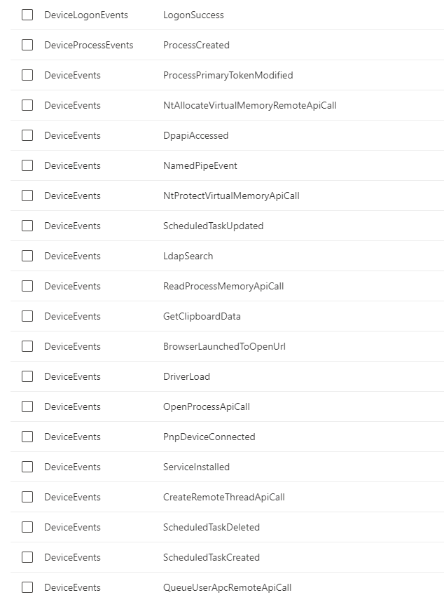
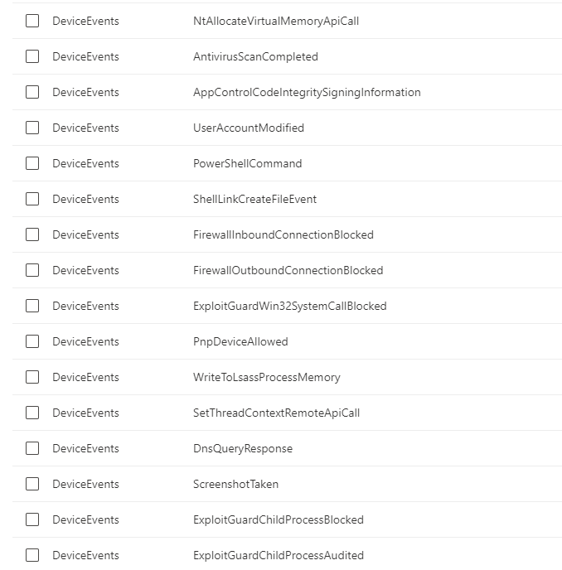
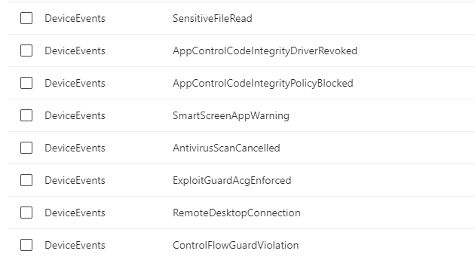
Microsoft Defender for Endpoint
Notes:
Mention - MDE NewCredential Limitation
Going to use MDE as an example moving forward only because the interface is beautiful

Slide 15
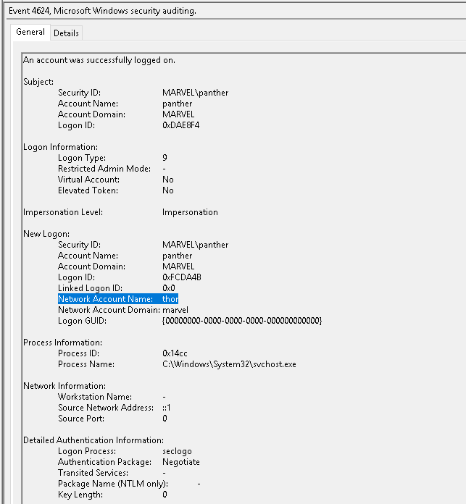
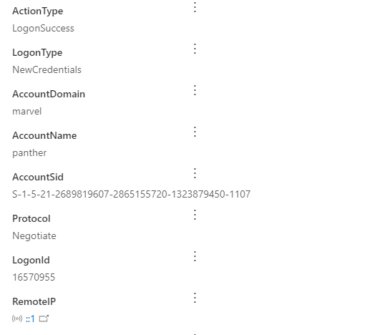
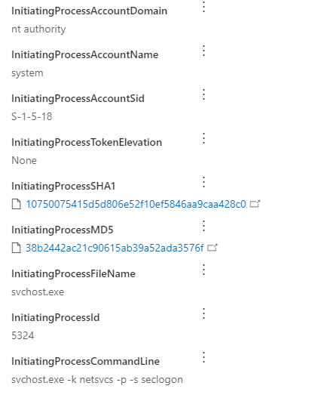
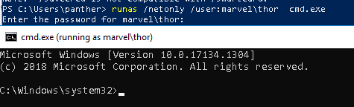
MDE NewCredential Limitation

Slide 16
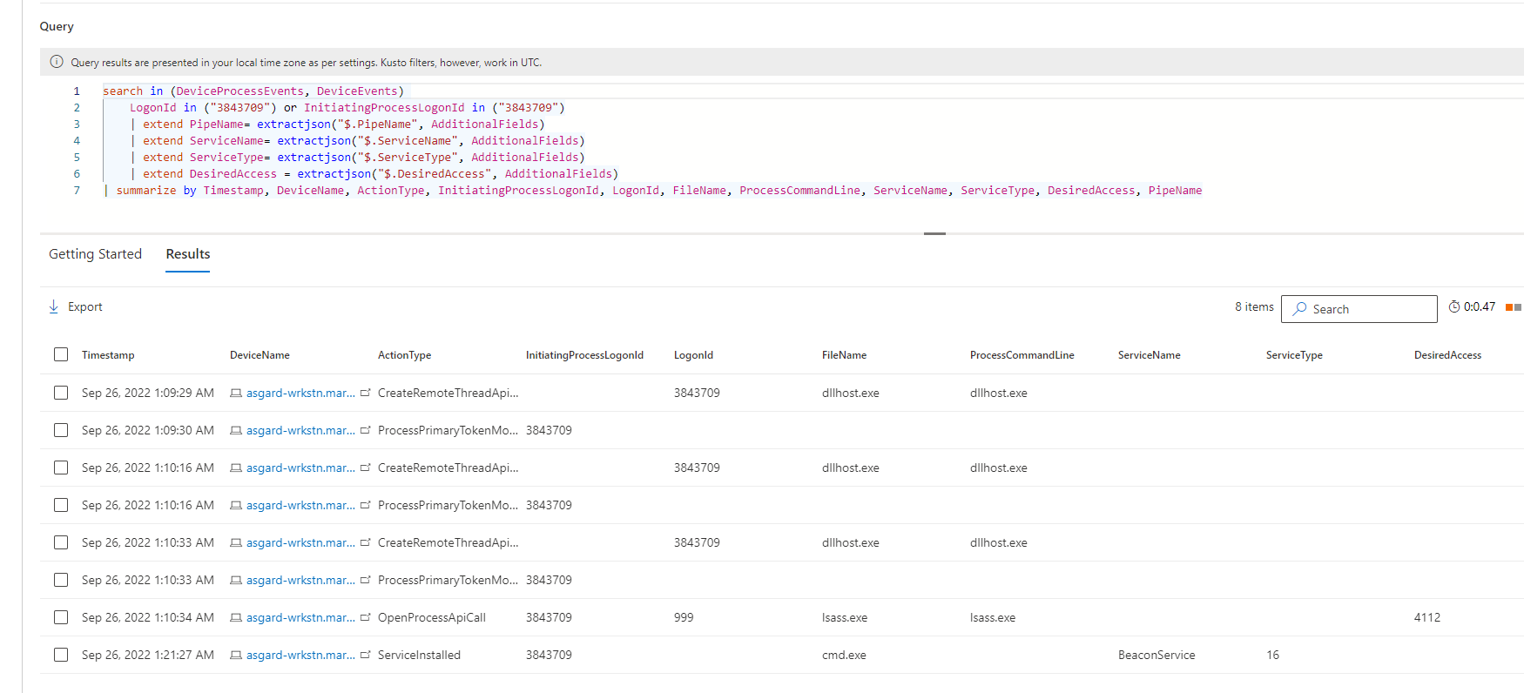
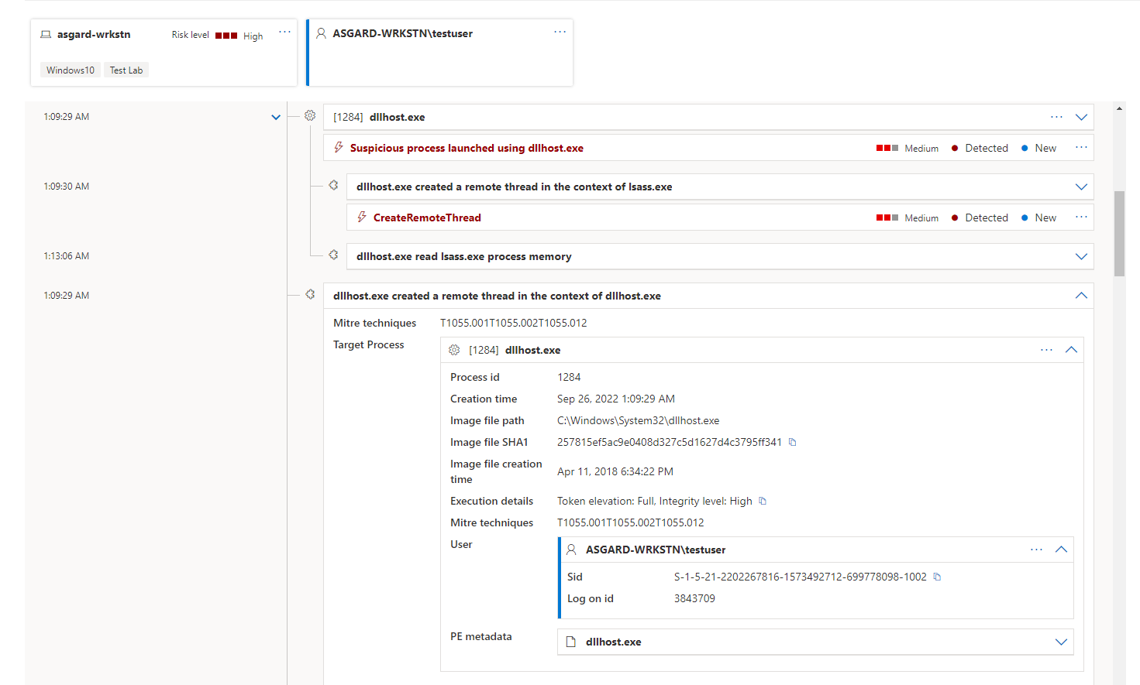
Practical Examples (Credential Dumping)
Notes:
Beacon was dropped
Mimikatz logonpasswords was ran to dump creds from LSASS
Service was created

Slide 17
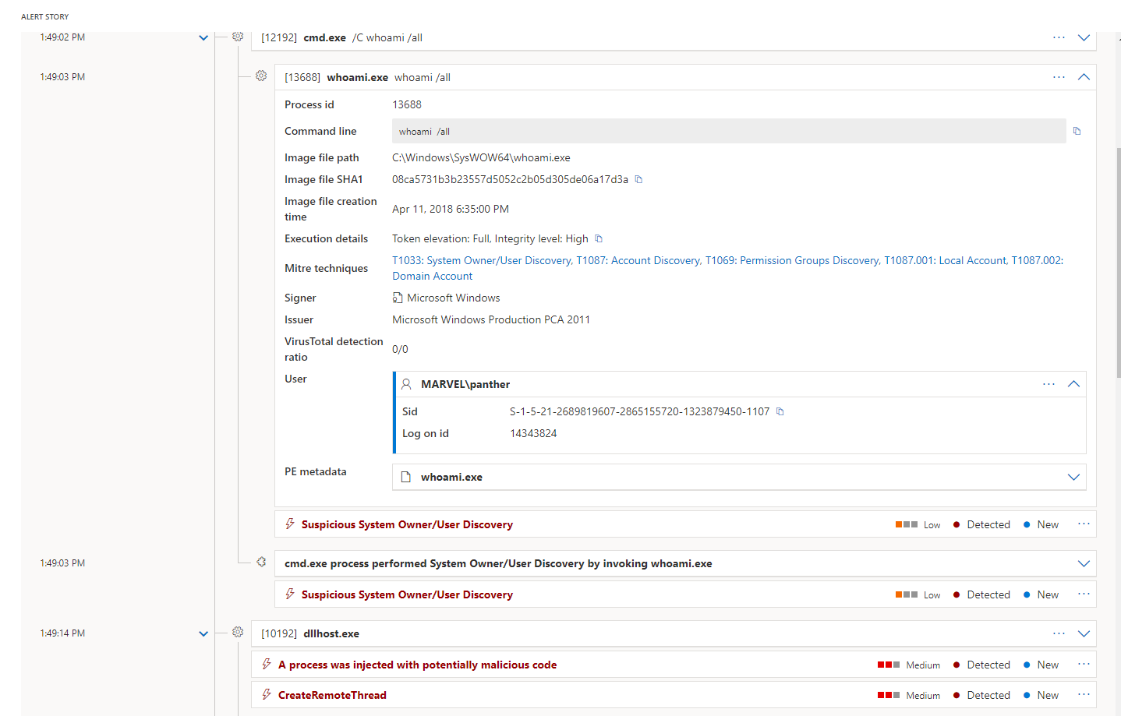
Practical Examples (Privilege Escilation)
A process was injected with potentially malicious code
Notes:
Process Injection Alert

Slide 18
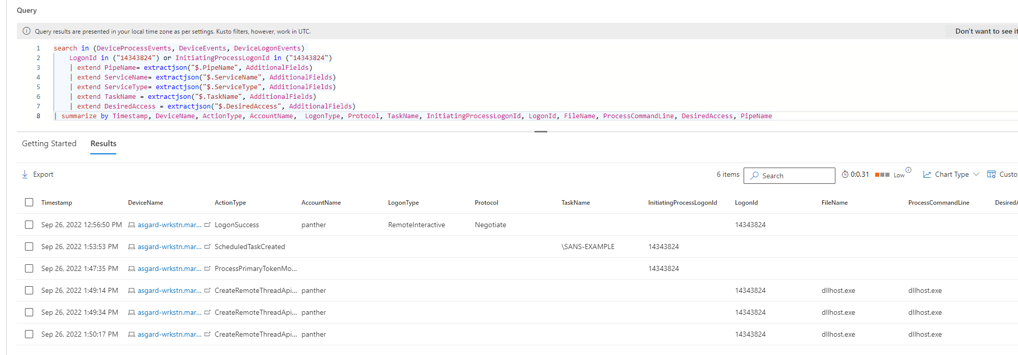
Practical Examples (Privilege Escilation)
A process was injected with potentially malicious code
Notes:
Process Injection Alert

Slide 19
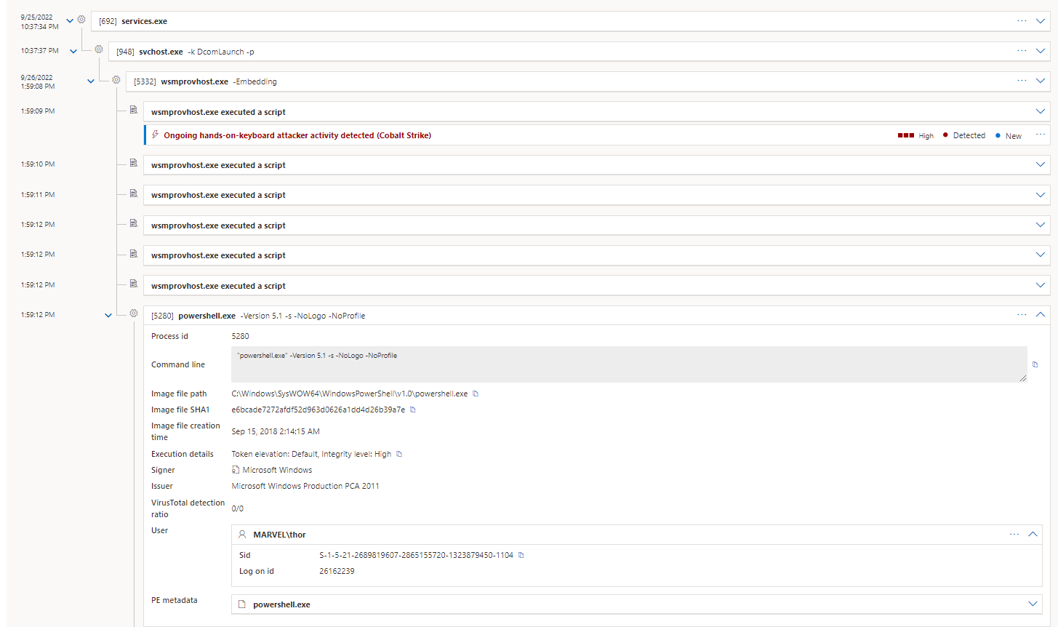
Practical Examples (Lateral Movement)
Ongoing hands-on-keyboard attacker activity detected (Cobalt Strike)
WinRM

Slide 20
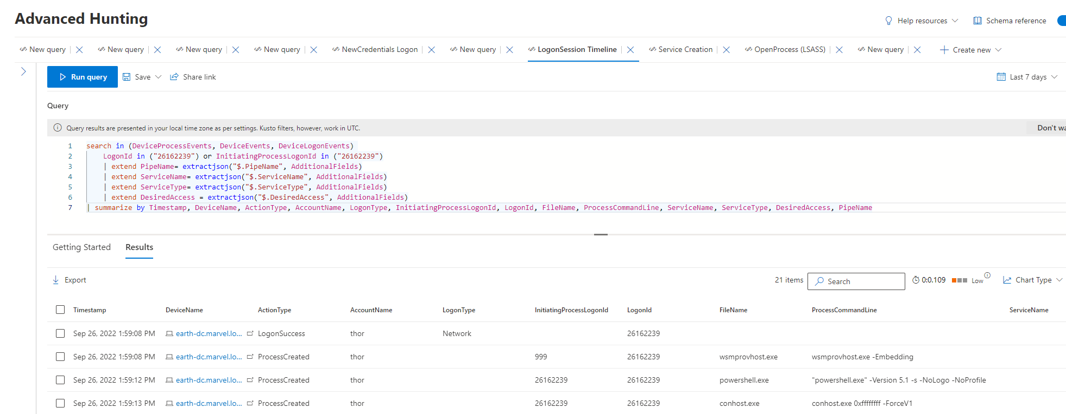
Practical Examples (Lateral Movement)
Ongoing hands-on-keyboard attacker activity detected (Cobalt Strike)

Slide 21
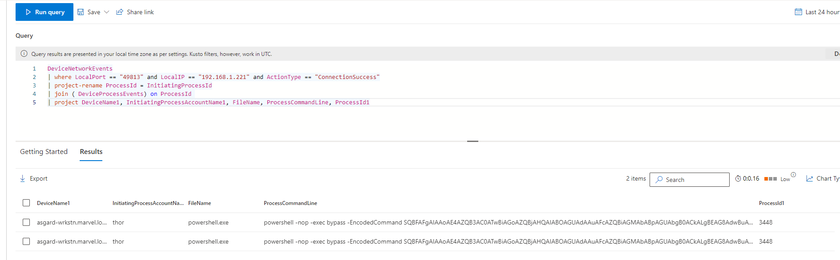
Practical Examples (Lateral Movement)
Ongoing hands-on-keyboard attacker activity detected (Cobalt Strike)

Slide 22
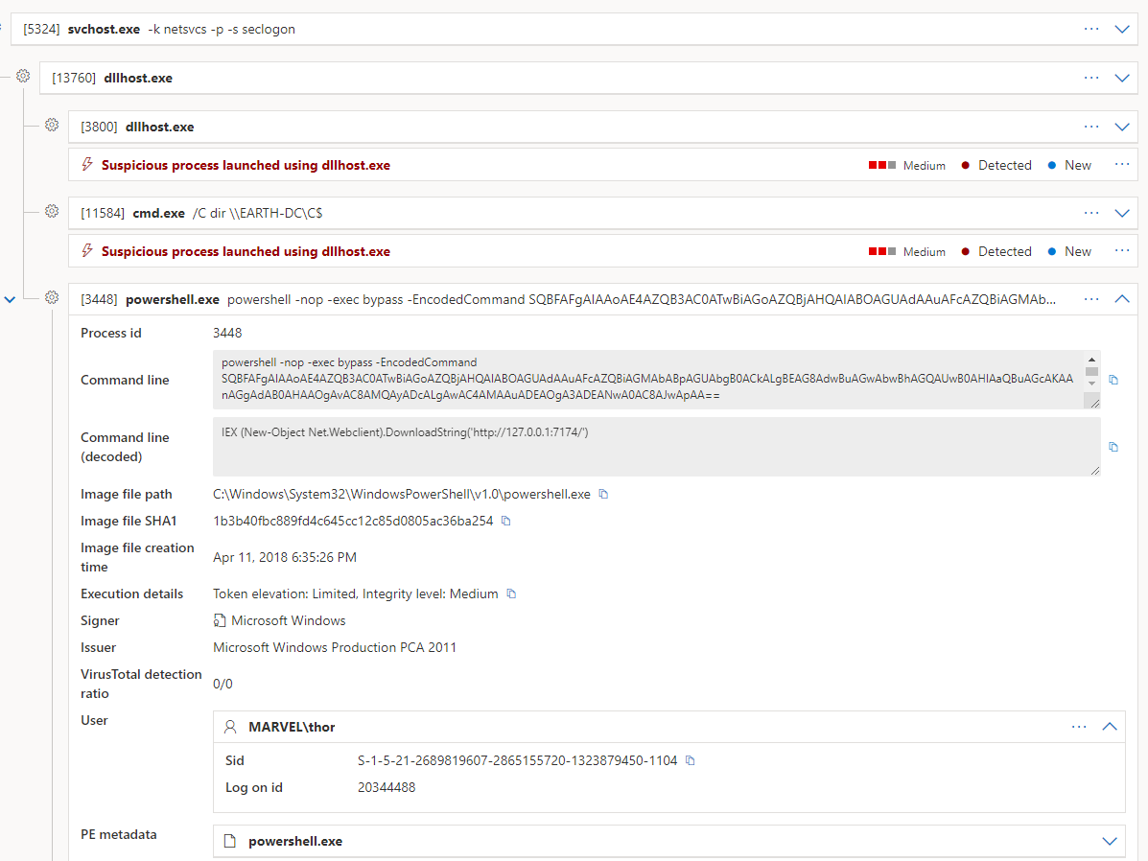
Practical Examples (Lateral Movement)
Suspicious process executed PowerShell command
Notes:
This is all limited testing with ONLY MDE.
Even more coverage with EDR + WSE, due to time I didn’t show this.
Detection – I was talking to a co-worker of mine Jared and he mentioned looking for Network Logons with a Process event is indicative of

Slide 23
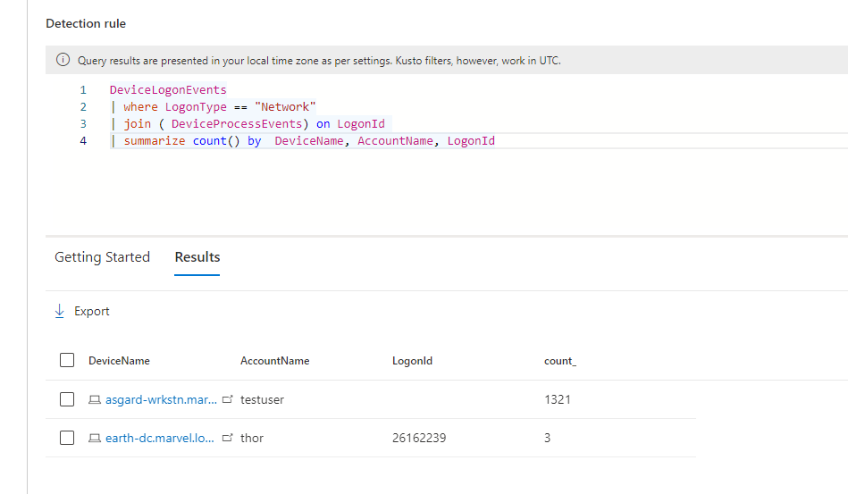
Practical Examples (Lateral Movement)
Detection
Notes:
Credit to Jared Atksinson
Network Type Logon with Process Creation is indicative of Lateral Movement.

Slide 24
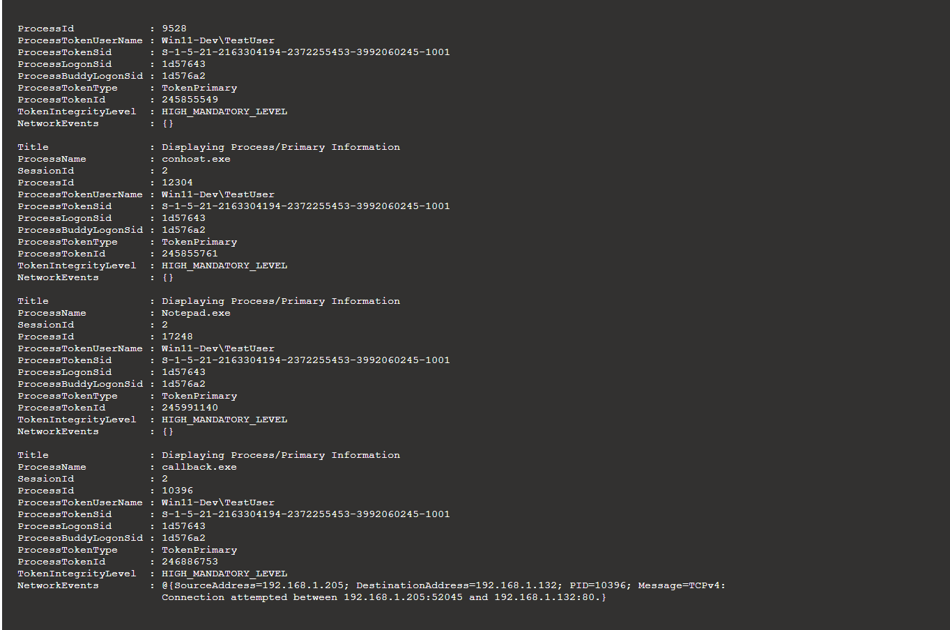
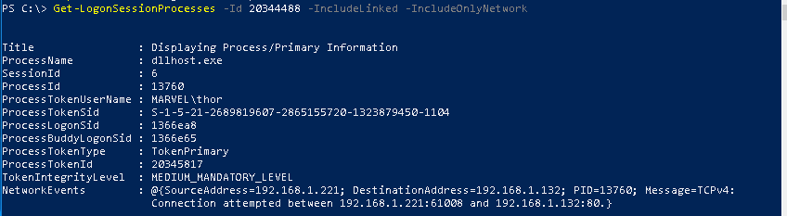
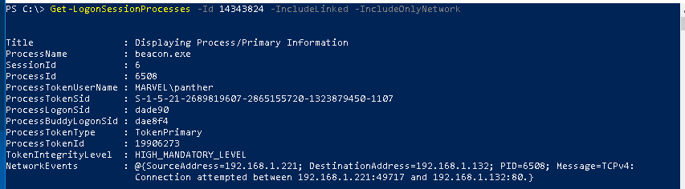
Investigation Script

Slide 25
Conclusion
Goal is to provide an initial targeted approach
Logon Session Centric Analysis is not meant to replace previous analysis methodologies
Other processes will still need to be used due to limitations in today’s telemetry
Really powerful with multiple data sources – Security Events + EDR!!
Notes:
Logon Session Centric Analysis is not meant to replace previous analysis methodologies – meant to help

Slide 26
Resources
Windows Internals Book Part 1, Chapter 7
Microsoft Authentication/Logon Documentations
LogonProcesses.ps1 - https://gist.github.com/jsecurity101/12e75415b35a5d220d13674e9ed43373

Slide 27
Q/A

